Slide 1
A Travel Reservations System Project. (easytravel)

Slide 2
Group 1 –EASYTRAVEL SYSTEM
Bridgette Yeboah
Odomero Omokahfe
Jelilat Anou
Tebogo Jessica
Ifeoma Veronica
Sara AbdEINagy
Hager Ashour
Tharollo Seakamela
Ajuma Obande

Slide 3

Executive Summary
easYtravel is a hotel reservation system that helps users make hotel bookings for their preferred destinations either for work or leisure as required for the Mini Project- Data Science and AI Engineering for Group 1. This system will display hotels in locations selected by users who log on to the system. They will be able to see the rates, ratings & reviews, room facilities etc. One of the key features or characteristics is that it is very responsive and users will find the interface friendly for bookings.

Slide 4

Problem identification
With the increasing demand for internet usage in the service providing industries, it has become extremely important for travelers to use Online hotel booking websites, apps, systems for their trips ( Baki,2019). It has become increasingly important for accommodation providers to uses these platforms for reaching out to potential customers(Llach et al.,2013). However, these websites present several challenges that can leave the user frustrated when making a hotel reservation. Some of these may include longer waiting times, long lists of hotels making it lengthy, trust with personal information etc.

Slide 5

Objectives/goals
The system will allow the user to ; Easily make a hotel reservation when they input their selected location, room preference, check-in and check-out dates

Slide 6
Functional requirements of the system
1. Welcome the user (Hello name, Welcome to easYtravel.com )
2. Location/Date - User sees all available locations where we have present or User inputs a location. The user also enters their check-in and check-out dates.
3. User selects their preferred hotel from the list.
4. The hotel selected takes the user to a page to make their booking where they input these:
First Name Last name Contact details Email address
5. Hotel Booking - user see all hotels with address available in the selected location with price range from minimum to maximum, user selects a hotel and type of room(studio, deluxe), user inputs a check in and check out date. If room is available for those days, user proceeds to enter number of guests and the system displays the total price(rate per room * number of lodging days). User confirms booking or exits if not interested.
6. Once booking is made, a confirmation message and booking ID is sent to the customer.

Slide 7
Methodology
This section addresses the methods used by us in building the system. Essentially, a methodology is a collection of methods, practices, processes, techniques, procedures, and rules. In project management, methodologies are specific, strict, and usually contain a series of steps and activities for each phase of the project's life cycle. So, in our Project, we collected data from different references, documents, manual and different online booking sites. we have a basic knowledge about Search Engine Optimization and other, also we need Knowledge about the other reservation system and tourism sector. We have developed a set of necessary requirements to solve the main problem on which the project is based, using the necessary tools for. Therefore, we highlight on our contextual framework: Project Coding With the use of python programming languages, the system design is implemented. The code that we will use will be tested and errors are debugged. Software Requirements, Operating System, Web Browser, Language: python, Web Applications, Database and Server Deployment.

Slide 8

METHODOLOGY….methods
In developing the easYtravel reservation system, various functional requirements were considered which would contribute to a seamless user experience.
To allow the user broad access to a variety of hotels in different locations, a hotel API from Rapid API was used.
Coded with Python, the API was integrated with the system allowing the user to further insert check in and check out dates, room types, review hotel facilities and so forth.
The code further allows the user to see the booking, receive a booking ID, get a cost estimate and make payment online.
A Python dictionary stores the information input by the user, therefore confirming the booking not only to the user but to the hotel as well. An employee feature was also coded into the system, allowing the hotel employee to view bookings and payments.
Finally, the system was tested extensively for bugs and errors which may potentially arise. The employee interface was also tested to ensure cohesion between the user interface and the hotel backend. Ultimately, a responsive travel system has been configured which meets the needs of the user as defined in the functional requirements.

Slide 9
SOLUTION/KEY FEATURES OF EASYTRAVEL
Saving the customers data in the booking database, secretly and securely
Using the reservation system by all of the hotels all over the world.
Balance between price and quality of the hotel rooms.
Helping / providing the customer by booking services in anytime, anywhere and more quickly through the rate process on our system that will encourage the tourism and hotel establishment use the best practice/ways for achieving customer satisfaction and high prots.

Slide 10
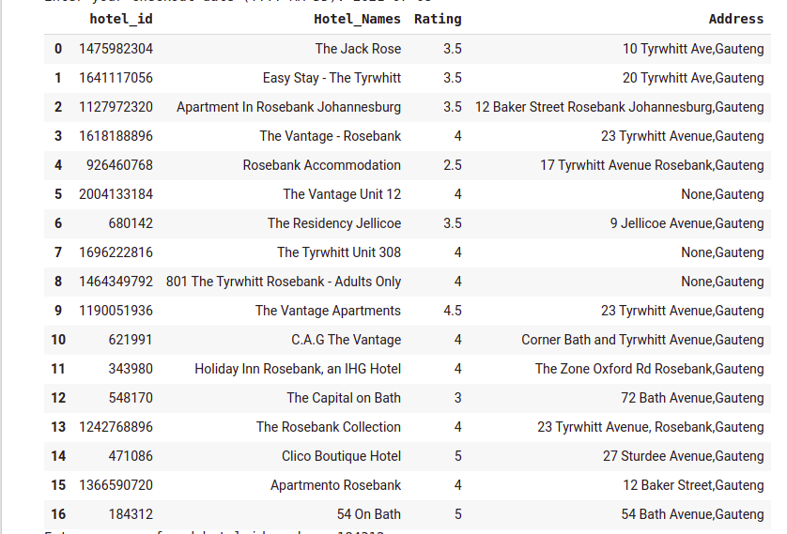
SEARCH&RESULTS SAMPLE

Slide 11
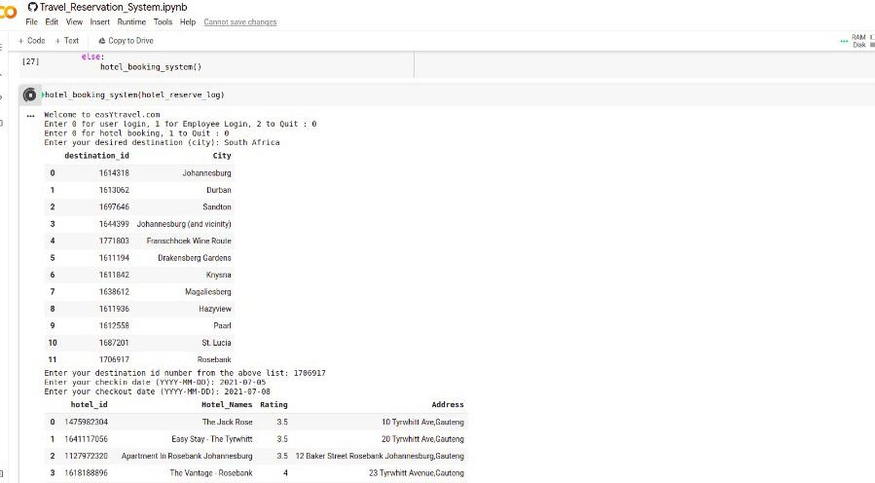
SAMPLE

Slide 12
CONCLUSION
Essentially, easYtravel will make it easier and quicker for users to make hotel reservations for their preferred destinations.

Slide 13
references
Baki, R., Birgoren, B., & Aktepe, A. (2018). A meta analysis of factors affecting perceived usefulness and perceived ease of use in the adoption of e-learning systems. Turkish Online Journal of Distance Education, 19(4), 4-42.
Llach, J., Marimon, F., del Mar Alonso-Almeida, M., & Bernardo, M. (2013). Determinants of online booking loyalties for the purchasing of airline tickets. Tourism Management, 35, 23-31.
APIlink; https://rapidapi.com/apidojo/api/hotels4

